Slide 1
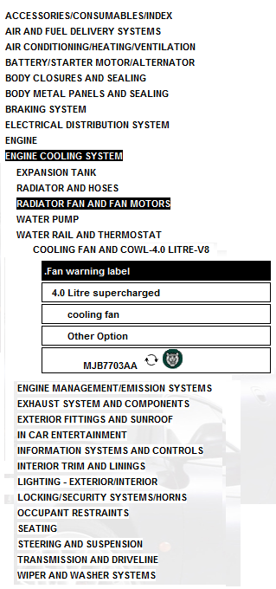
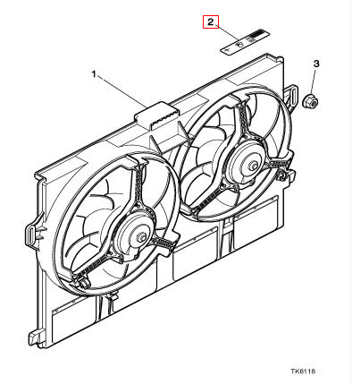
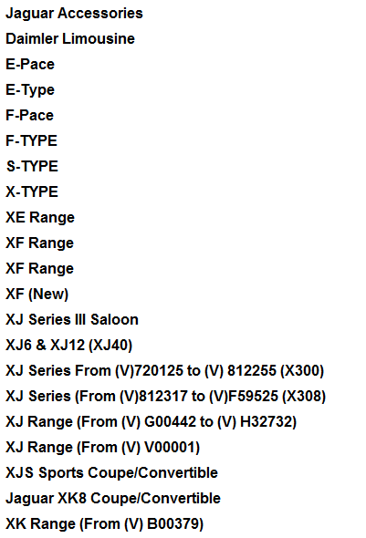
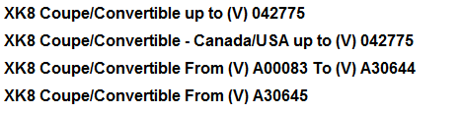
Search part #: MJB7703AA
X
X
X
X

Slide 2
Search part #: MJB7703AA
Parts tree
Part exploding image
Location at car:
Front, Middle
Fits to car models
X
X
X
X

Slide 3
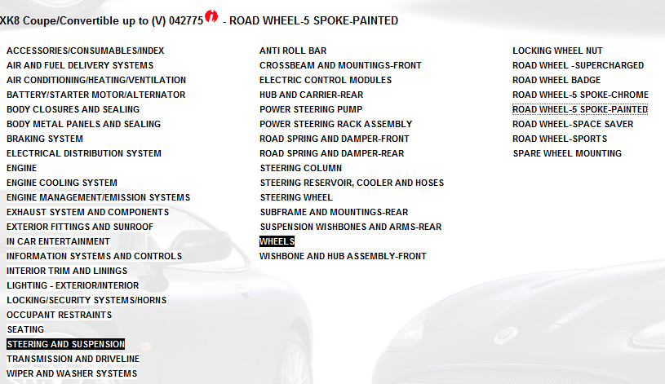
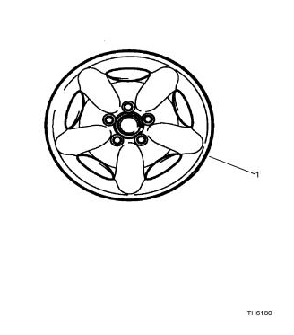
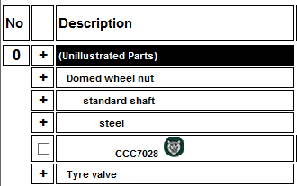
Search part #: MJB7703AA
Parts tree
Part exploding image
Location at car:
Front, Rear, Left, Right
Fits to car models
X
X
X
X

